Slide 1
Praktyczne wykorzystanie architektury Lambda do przetwarzania Big Data
na platformie Azure
Gliwice 2018.12.01
Author:
Tomasz Krawczyk
Notes:
Nazywam sie TK –aktualnie wsplpracuje z firma FP w takiej komorce ktora nazywa sie Data Solution
– jak moje córki pyta co robie to mowie ze bawie sie chmura a dokladaniej zajmuje sie przetwarzaniem duzych zbiorow danych w chmurze Azure
Dzis chcialbym Wam odpowiedziec o jdenych z moim zabawek – generlanie to chcialbym odpowiedziec jak ja zaczynalem swoja przygotoge z Big Data,

Slide 2
Agenda
Big Data
Processing (Theory)
First Big Data Project
Azure Platform
Big Data Services
Solutions
Notes:
I my zeby tak gwaltownie niezaczac

Slide 3
163 Zetta bytes by 2025
163 Zetta bytes =
163 000 000 000 000 000 000 000 bytes
163 *2⁷⁰ bytes 163 * 1024⁷ bytes
If 1 bytes = One grain of rice
then Zetta byte = Fills the Pacific Ocean
Watching the Netflix catalogue
489 million times

Slide 5
Lambda Architecture
COLD PATH
Input
Data
All Data
Precomputed Views
BATCH LAYER
Batch View
Queries
Real Time View
Recent Data
Incremental Views
SPEED LAYER
HOT PATH

Slide 6
Data Lake Approach
What is Data Lake ?
“If you think of a datamart (a subset of a data warehouse) as a store of bottled water – cleansed and packaged and structured for easy consumption – the data lake is a large body of water in a more natural state„
Pentaho CTO James Dixon
I(ngest) S(tore) A(nalyse) S(urface) A(ct)

Slide 7
Big Data Project
IoT Data
30 TB Initial Load
15 GB Daily Load (Batch Mode)
Wide Spectrum of Query Analysis
Detailed Queries (Point Queries)
Queries with lot of aggregations
Full scan queries

Slide 8








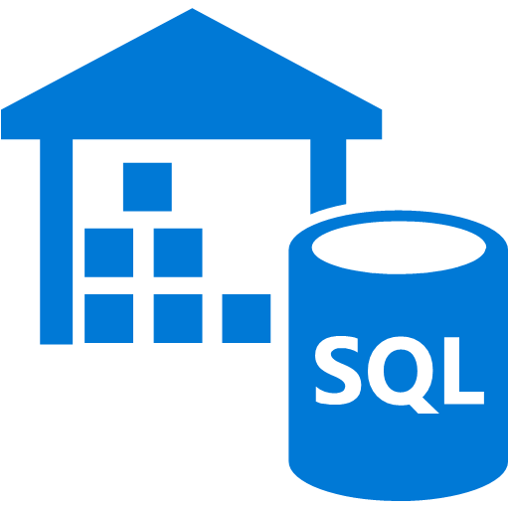
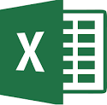
Azure – Lambda architecture (Cold Path)
Storage
Input
Data
Azure Blob Storage
Azure Data Lake Storage
(Gen1)
Azure Data Lake Storage
(Gen2)
Web Application
Ingest
Interactive Query Engine
Power BI
Azure Data Factory
PULL
Azure HDInsight
Azure Data
Lake Analytics
Azure Databricks
Azure Data
Warehouse
Analyse
Excel

Slide 9
Azure Blob Storage
Azure Data Lake Storage (Gen1)
General purpose object store (containers > blobs)
Object store with flat namespace
Hot/cold/archive tiers
Data replication and redundancy options
Azure Data Lake Storage (Gen2)
Multi-modal combining features from both of the above
Not a separate service: Azure Storage with new features

Slide 10
Big Data in Azure: Compute
Higher level of complexity, control, & customization
Easiest entry point
to get started
Cluster as a Service (PaaS)
Hadoop, Hbase, Storm, Spark,ML Server, Hive LLAP, Kafka
Integration with many data sources /sinks
Python, Scala, R, SQL
Apache projects and/or greater control over clusters
Running a managed, optimized Spark framework(PaaS)
Integration with many data sources /sinks
Integration with Azure services (e.g. Azure Data Factory, Azure Data Warehouse)
Integration with Azure Active Directory
Easy Deployment
Utilizing Spark in a variety of ways
Python, Scala, R, SQL
Less
administrative
effort
Azure Data
Lake Analytics
Query as a Service (PaaS)
Pay PER QUERY & Scale PER QUERY
Limited integration with data sources /sinks
Optimized to work with ADL Store
U-SQL, Python, R, C# ,Cognitive
Integration with ADF
Azure Databricks
Greater
administrative
effort
Azure HDInsight
Higher level of complexity, control, & customization
Less integration
with various Apache
projects

Slide 11
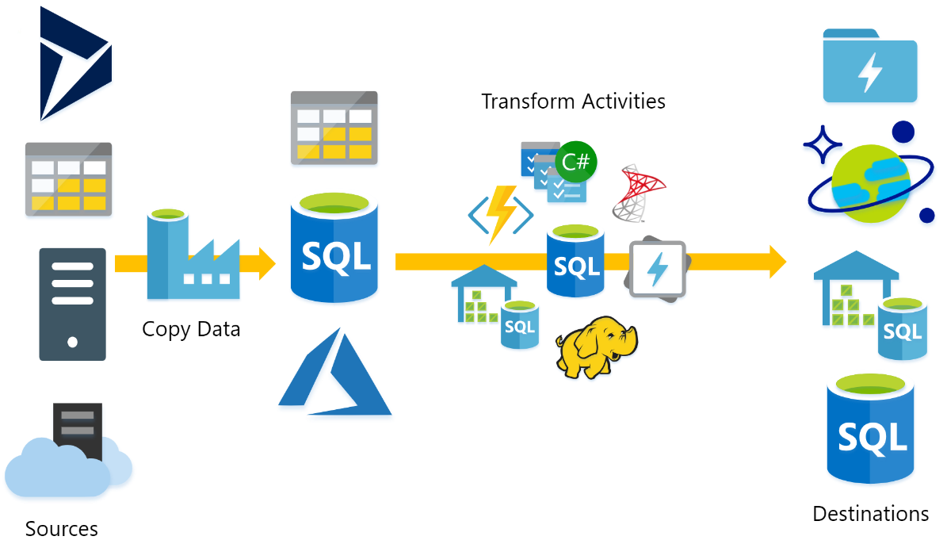
Azure Data Factory
Fully managed service to support orchestration of data movement and transformation
Connect to relational or non-relational data that is on-premises or in the cloud
Data movement activities : Copy Activity
Data transformation activities :
HDInsight (Hive, Pig, MapReduce ,Hadoop Streaming ,Spark)
Databricks Notebooks (V2)
Machine Learning activities: Batch Execution and Update Resource (*)
Stored Procedure
Data Lake Analytics U-SQL
DotNet (Custom)

Slide 12
Azure Data Factory –Azure HDInsight and Azure Data Lake Analytics

Slide 13
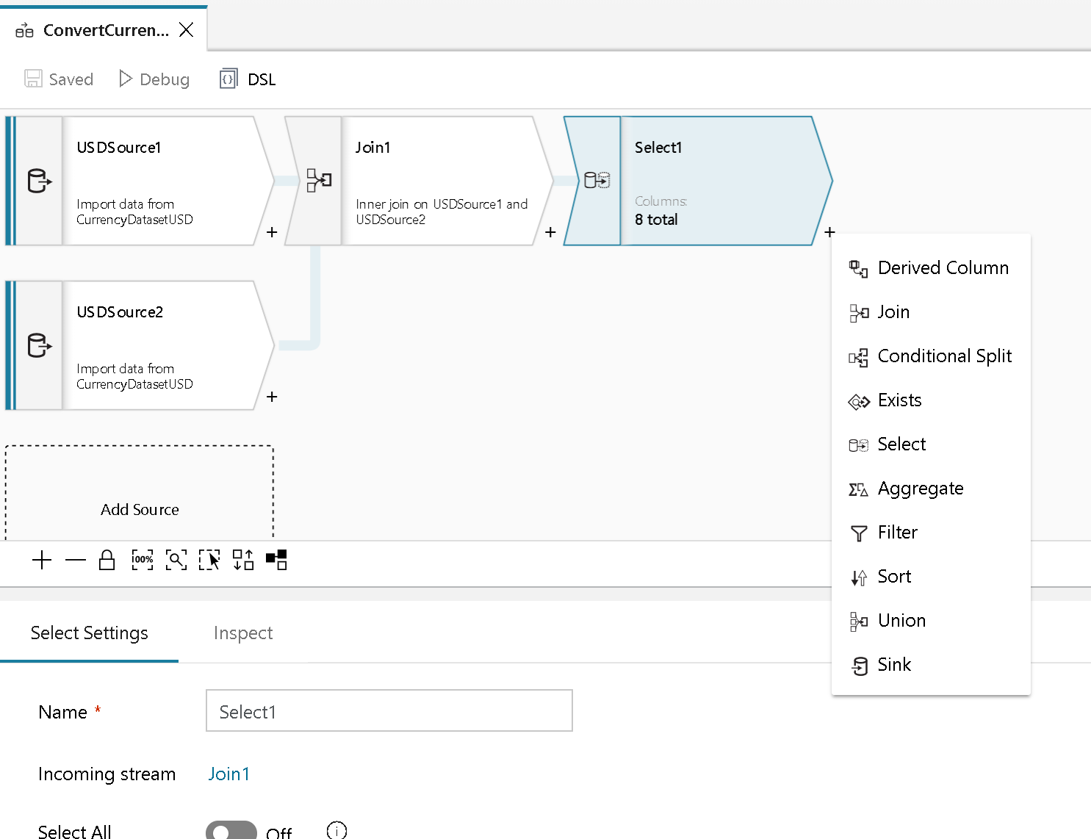
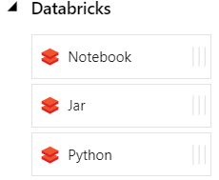
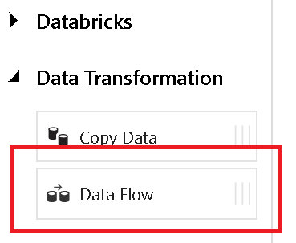
Azure Data Factory- DataFlow (Preview)
+
Azure Data Factory
Azure Databricks

Slide 14
Interactive Queries

Slide 15
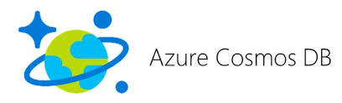


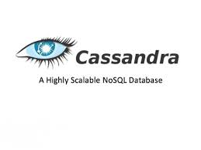



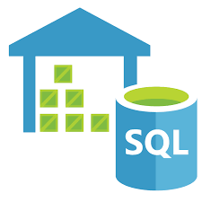

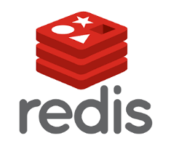

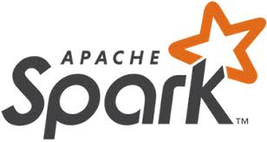

Database solutions
Azure Data Warehouse

Slide 16
Data Partitioning

Slide 17
Solutions

Slide 18
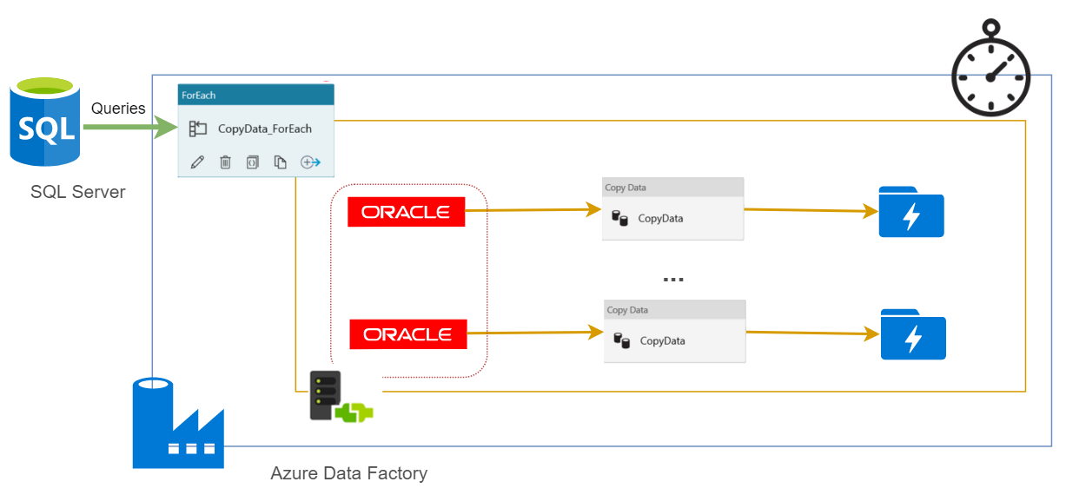

Slide 19
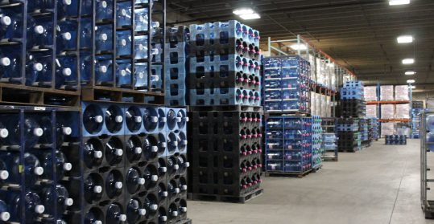

Data Processing
ETL (Extract Transform Load) - Schema On-Write
Data Warehouse
ELT (Extract Load Transform) - Schema On-Read
Data Lake
Source: https://premiumwaters.com
What is Data Lake ?
“If you think of a datamart (a subset of a data warehouse) as a store of bottled water – cleansed and packaged and structured for easy consumption – the data lake is a large body of water in a more natural state„
Pentaho CTO James Dixon
I(ngest) S(tore) A(nalyse) S(urface) A(ct)
Source :https://snowbrains.com
Notes:
For the last couple of decades ETL (extract, transform, load) has been the traditional approach for data warehousing and analytics. The ELT (extract, load, transform) approach changes the old paradigm. But, what’s actually happening when the “T” and “L” are switched?

Slide 20
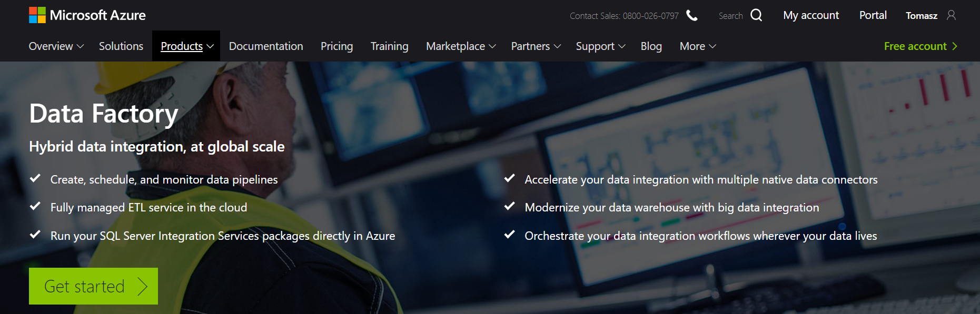
Azure Data Factory (V2)
https://azure.microsoft.com/en-us/services/data-factory/
Notes:
Fully managed service to support orchestration of data movement and transformation
Connect to relational or non-relational data that is on-premises or in the cloud
Allows monitor and manage data processing pipelines
Version 1 and 2 (+SSIS)

Slide 21
What does ADF do?
Source : P.Andrew

Slide 22

Azure Data Factory Concept
Dataset
(eg. tables, files)
Activity
(eg. Copy, Hive job,
SP, ADLA job)
Pipeline
(schedule,monitor,
manage)
Consumes
Is a
logical
grouping of
Produces
Represents
data item(s)
stored in
Runs on
Linked Services
(eg. SQL Server,
HDInsight,ADLA)
Triggers
Notes:
Activities
Actions you perform on your data
Inputs turned into outputs
Pipelines
Logical grouping of activities for group operations
Data sets
A named reference/pointer to data you want to use as an input or output of an activity
Linked services
Connection of data factories to the resources and services you want to use
Connection of data stores like Azure storage and on-premises SQL Server
Connection of compute services like Azure Machine Learning, Azure HDInsight, and Azure Batch

Slide 23
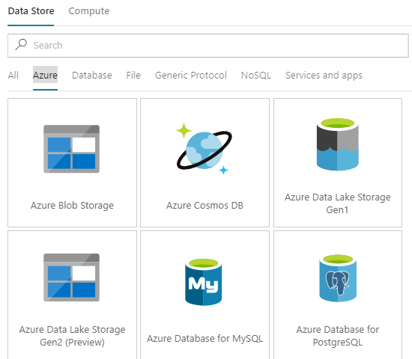
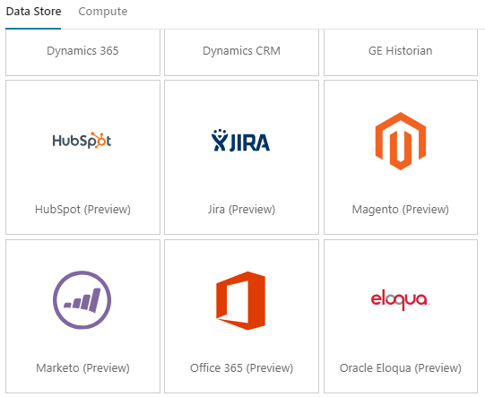
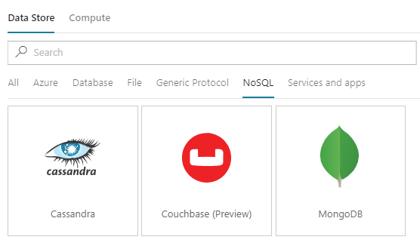
Azure Data Factory – Linked Services
More than 70 connectors

Slide 24
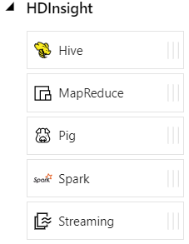
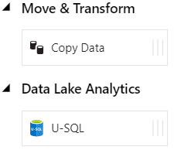
Azure Data Factory - Data activities
Data movement activities : Copy Activity
Data transformation activities :
HDInsight (Hive, Pig, MapReduce ,Hadoop Streaming ,Spark)
Databricks Notebooks (V2)
Machine Learning activities: Batch Execution and Update Resource (*)
Stored Procedure
Data Lake Analytics U-SQL
DotNet (Custom)

Slide 25
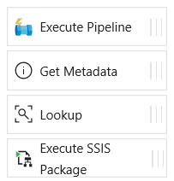
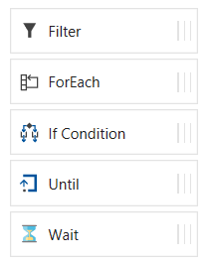
Azure Data Factory - Control flow activities
Execute Pipeline Activity
ForEach Activity
Web Activity
Lookup Activity
Get Metadata Activity
Until Activity
If Condition Activity
Wait Activity

Slide 26
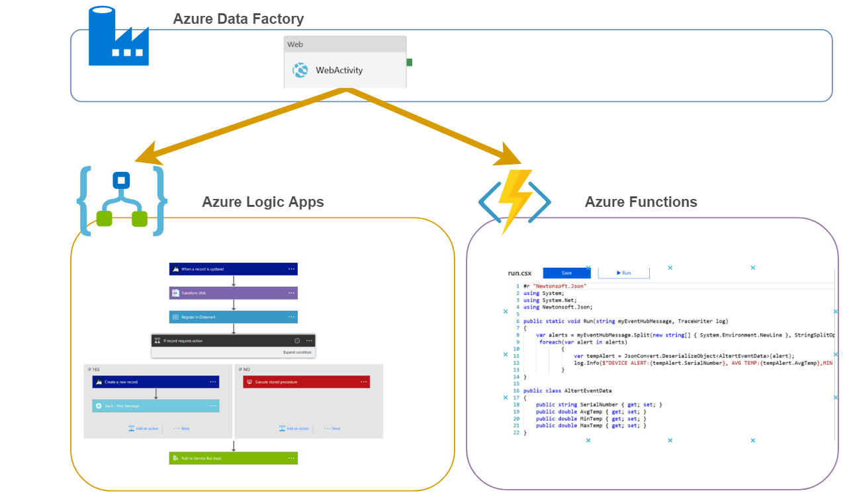
Azure Data Factory – Web Activity
Rest API Calls

Slide 27
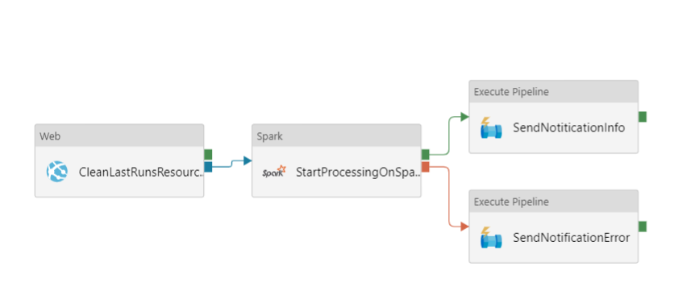
Azure Data Factory – Web Activity Example

Slide 28
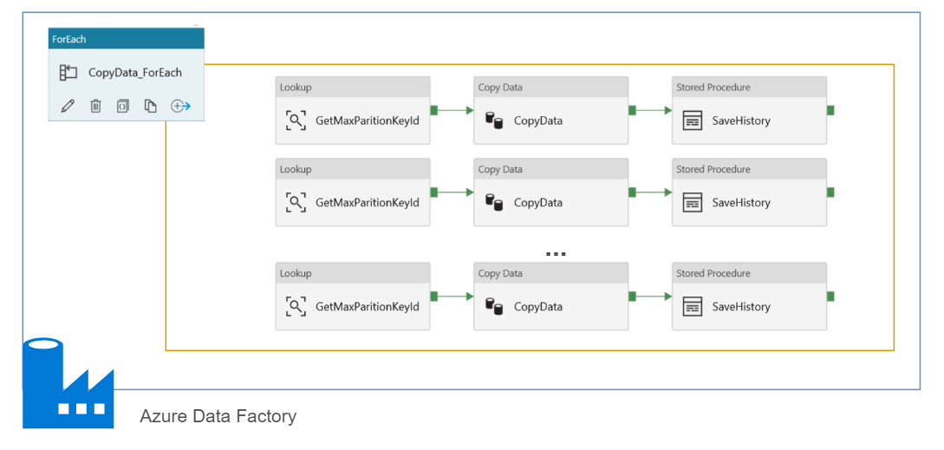
Azure Data Factory – ForEach
Max 20 DOP

Slide 29
Azure Data Factory – What else ?
Parameters
Expressions
Dynamic Content
Functions
Branching
On success
On failure
On completion
Activity 2
On success
Activity 1
(eg. Copy, Hive job,
SP, ADLA job)
Activity 3
On completion
On failure
Activity 4

Slide 30
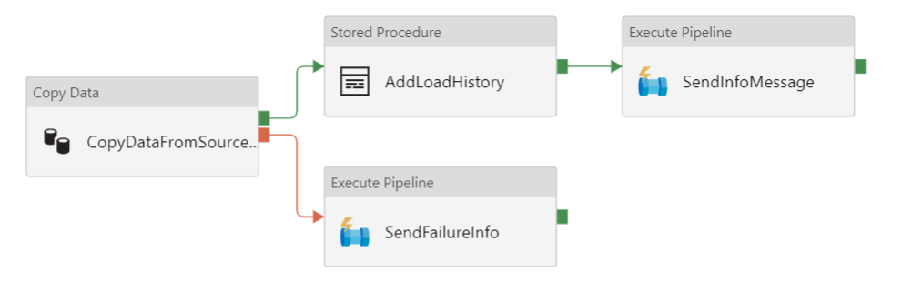
Azure Data Factory –Branching

Slide 31
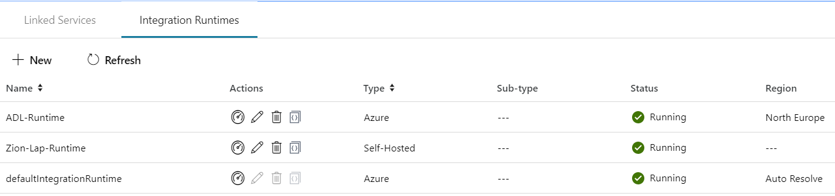
Integration runtime(s) in Azure Data Factory
The Integration Runtime (IR) is the compute infrastructure used by Azure Data Factory to provide the following data integration capabilities across different network environments
Integration runtime types:
Azure (Data movement and activity on Azure)
Self-hosted (Data movement and activity dispatch between public and private network)
Azure-SSIS (SSIS package execution)

Slide 32

Self Hosted Integration runtime
Now called Self Hosted Integration Runtime
Before Data Management Gateway
One version for ADF V1 and V2
SSL Port : 443
One to Many

Slide 33
Azure Data Factory- DataFlow (Preview)
+
Azure Data Factory
Azure Databricks

Slide 34
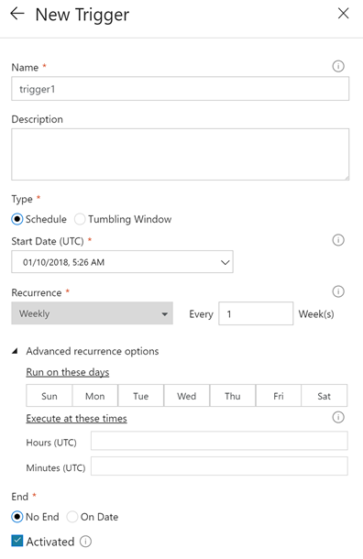
Pipeline execution and triggers in Azure Data Factory
Manual execution (on-demand)
The REST API
The .NET SDK
Trigger execution
Schedule trigger
Tumbling window trigger

Slide 35
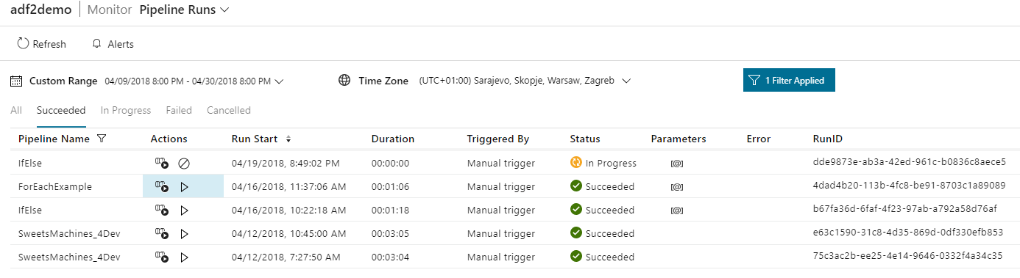
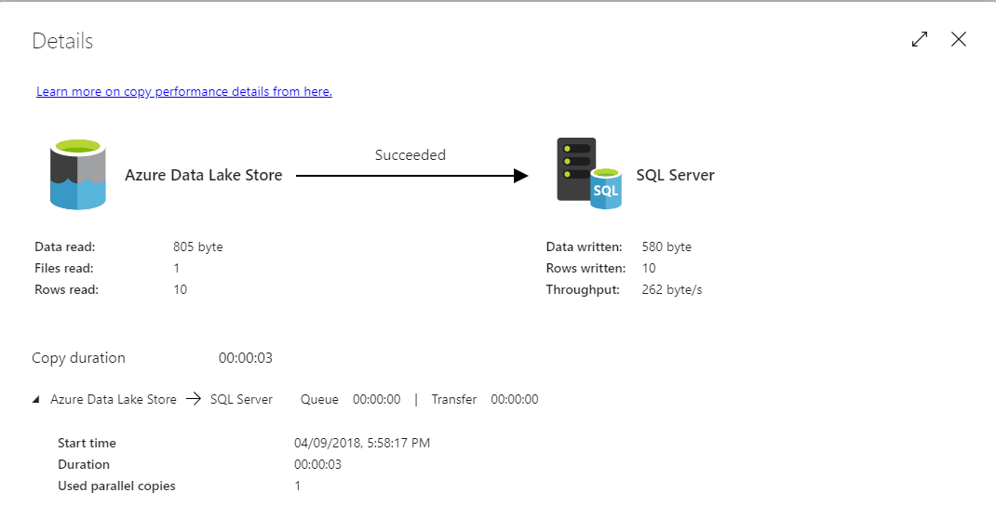
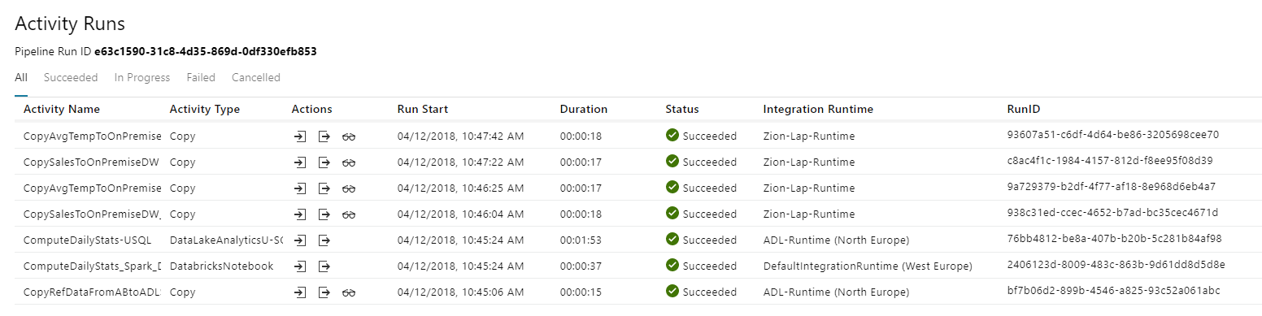
Azure Data Factory Monitoring

Slide 36
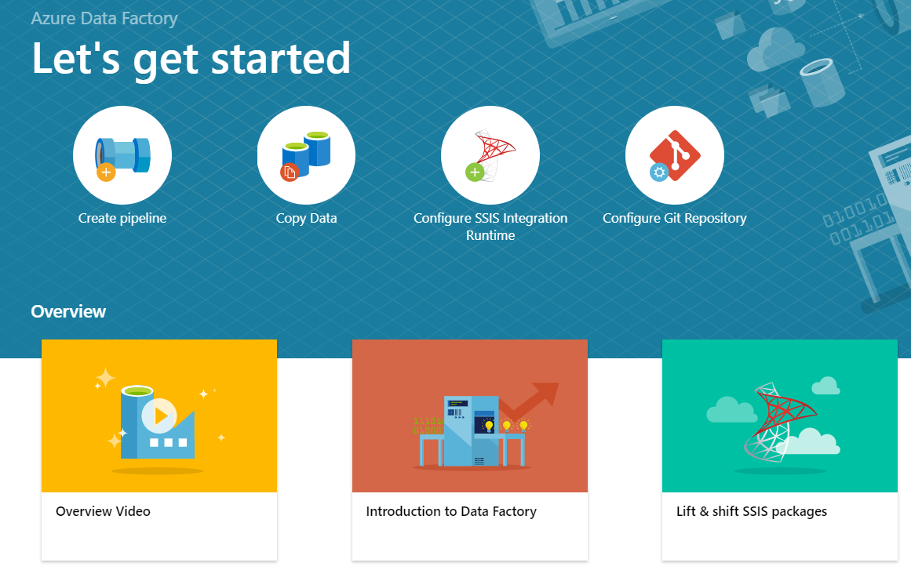
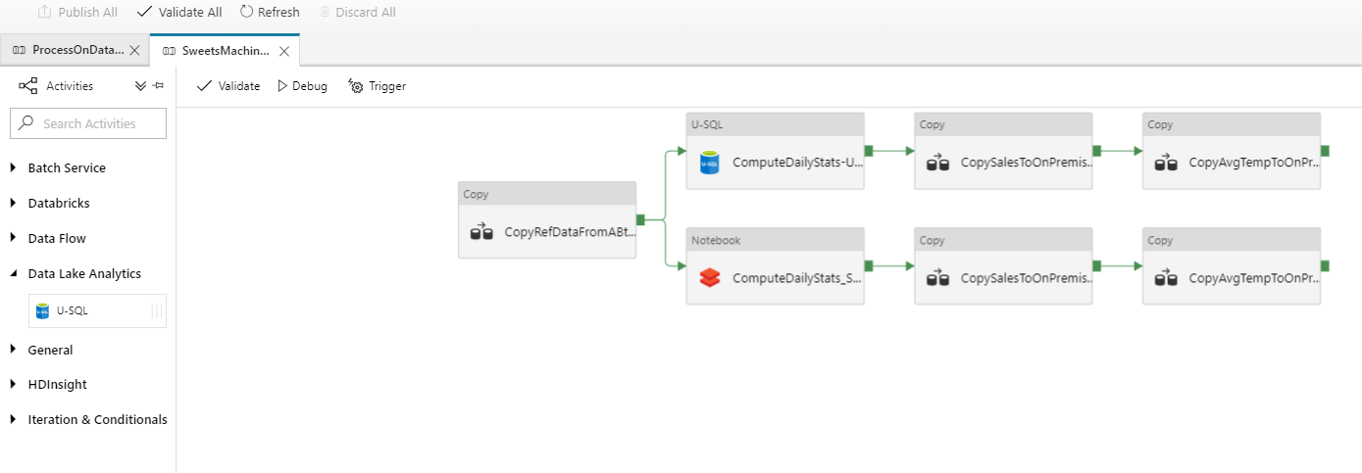
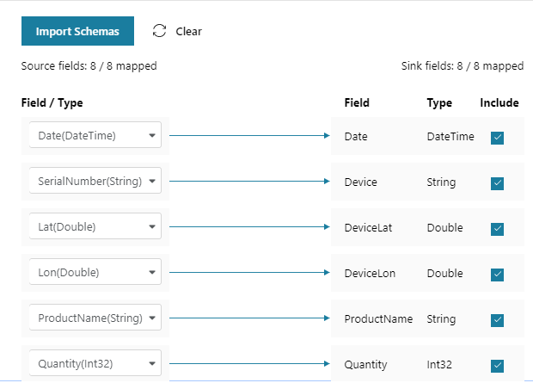
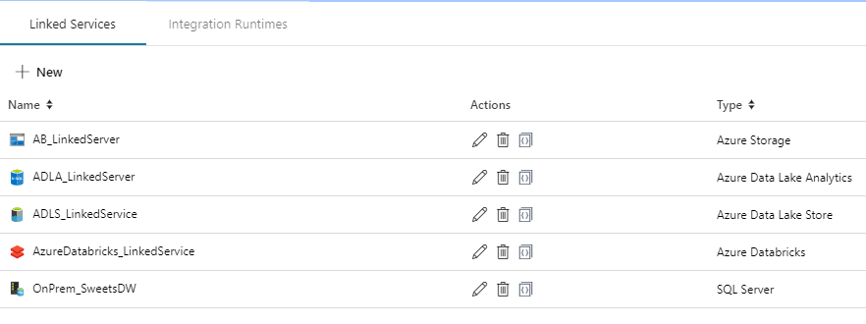
Azure Data FactoryTools
ADF V2 Web Designer (Azure Portal)

Slide 37
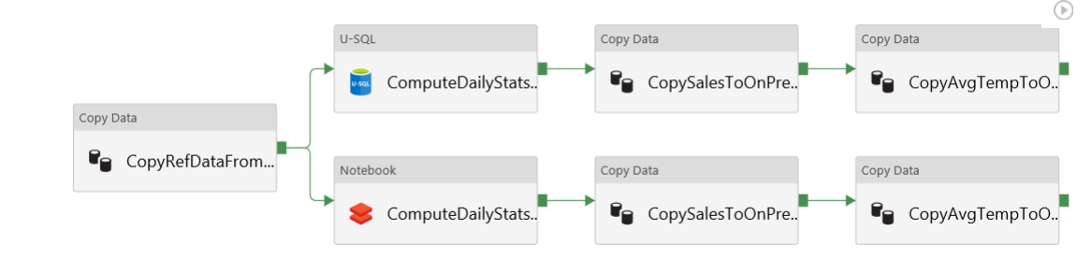
Azure Data Factory – Sample Pipeline

Slide 38
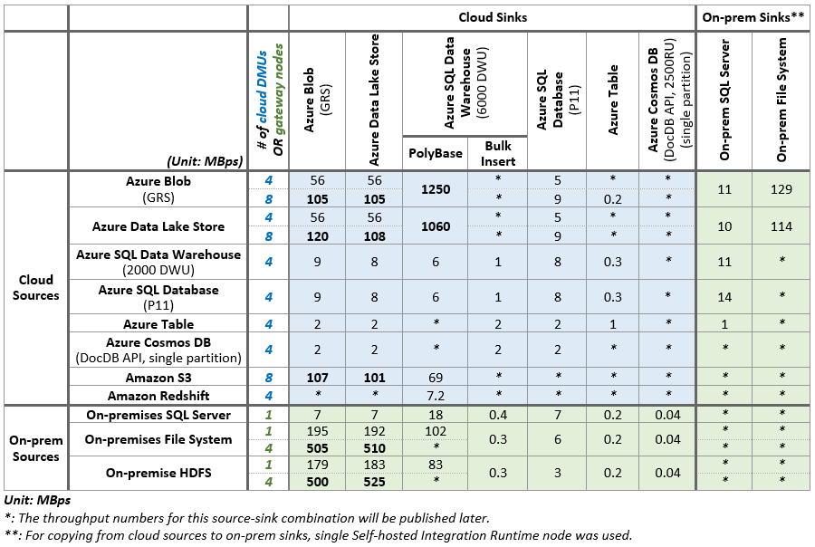
Azure Data Factory Performance
https://docs.microsoft.com/en-us/azure/data-factory/copy-activity-performance

Slide 39
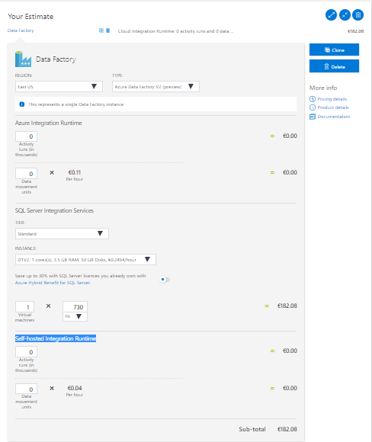
Azure Data Factory Costs
Costs depend on Integration Runtime:
Azure Integration Runtime
Activity runs (in thousands)
Data movement units
Self-hosted Integration Runtime
Activity runs (in thousands)
Data movement units
SQL Server Integration Services
Virtual machine(s) type e.g. D1V2 (h)
https://azure.microsoft.com/en-gb/pricing/calculator/

Slide 40
DEMO

Slide 41
Q & A

Slide 42
Resources
My examples (and demos)
https://github.com/cloud4yourdata/demos/tree/master/4DevKatowice2018/USQL
https://github.com/cloud4yourdata/usql/
Blogs and pages
http://aka.ms/AzureDataLake
http://usql.io
http://blogs.msdn.microsoft.com/mrys/
http://blogs.msdn.microsoft.com/azuredatalake/
Documentation, articles ...
http://aka.ms/usql_reference
https://azure.microsoft.com/enus/documentation/services/data-lake-analytics/
https://msdn.microsoft.com/en-us/magazine/mt614251
https://channel9.msdn.com/Search?term=U-SQL#ch9Search
https://www.youtube.com/results?search_query=U-SQL

Slide 43
THANK YOU!
tkrawczyk@future-processing.com

